Slide 1
Real-time 3D Rendering
Team 04
https://github.com/victoresque/HLS3D

Slide 2
Outline
Introduction
Algorithm Overview
Kernel Implementation
Design Optimization
System Integration
References

Slide 3
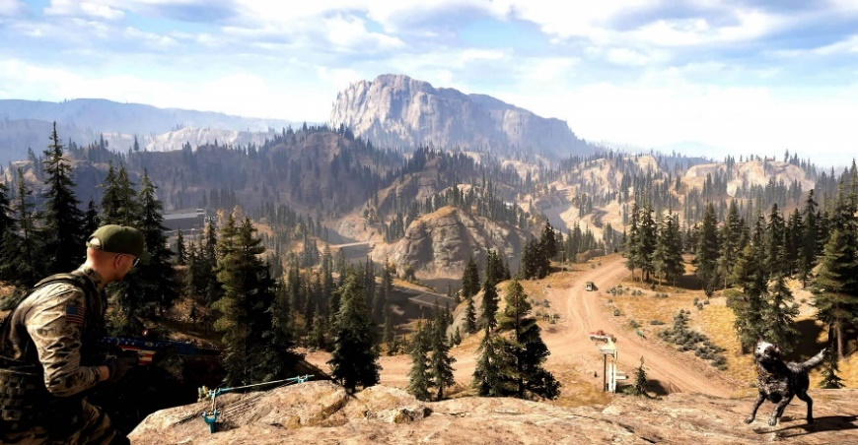
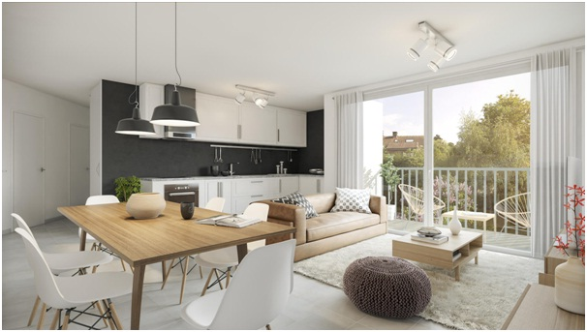
Introduction to 3D Rendering
Rendering: visualizing 3D objects and scenes
Applications
Real-time: video games, AR, …
Non real-time: movie, interior design, …
High computational complexity

Slide 4
Outline
Introduction
Algorithm Overview
Kernel Implementation
Design Optimization
System Integration
References

Slide 5
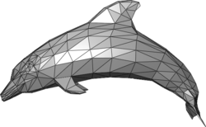
3D Object Representation
3D objects consist of vertices and faces/triangles
Each vertex contains these information:
Coordinates
Texture coordinates
Face norm vector
… and more

Slide 6
Rendering Process
Geometric transform
Visibility checking
Rasterization and interpolation
Texture mapping
Shadow mapping
Blending

Slide 7
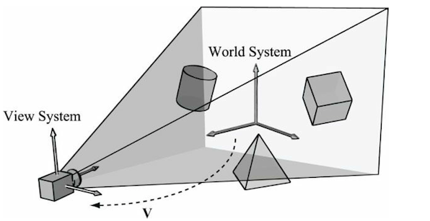
Geometric Transform
3D models are stored in object local coordinates
Moving an object around in a scene
from local coordinates to world coordinates
To simplify rendering computation
transform to camera coordinates
source: http://ycpcs.github.io/cs470-fall2014/labs/lab07-2.html

Slide 8
Visibility Checking
If two points projects to the same pixel, the closer one is visible
Use a depth buffer to track minimum distance per pixel
for point in scene:
pixel <- project(point)
if point.z < depth_buffer[pixel]:
depth_buffer[pixel] = point.z
// rasterization
p2
z
p1
p'
camera
q'
q1
projection
plane
q2

Slide 9
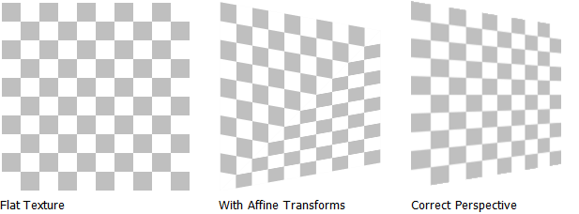
Interpolation (1/2)
Interpolation should consider perspective for correct results
naïve
perspective-corrected

Slide 10
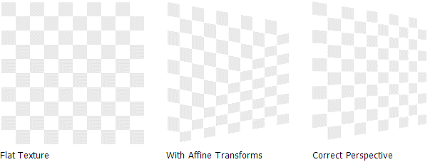
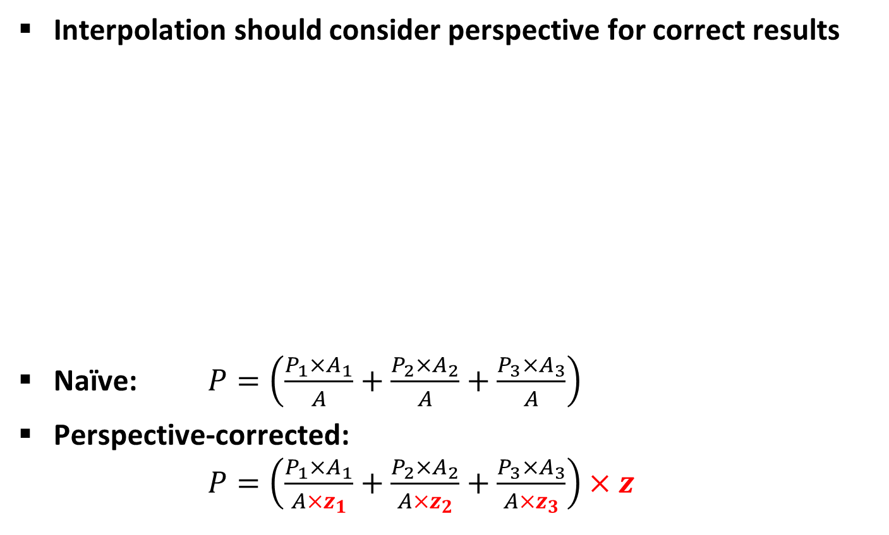
Interpolation (2/2)
Interpolation should consider perspective for correct results
Naïve: $P=\left(\frac{P_{1}×A_{1}}{A}+\frac{P_{2}×A_{2}}{A}+\frac{P_{3}×A_{3}}{A}\right)$
Perspective-corrected: $P=\left(\frac{P_{1}×A_{1}}{A×z_{1}}+\frac{P_{2}×A_{2}}{A×z_{2}}+\frac{P_{3}×A_{3}}{A×z_{3}}\right)×z$
P₁
P₃
A₂
A₃
A
A₁
P₂
naïve
perspective-corrected

Slide 11
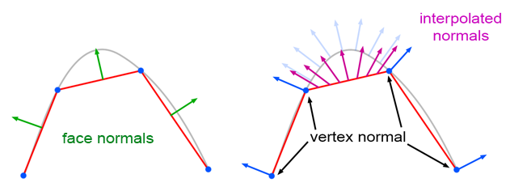
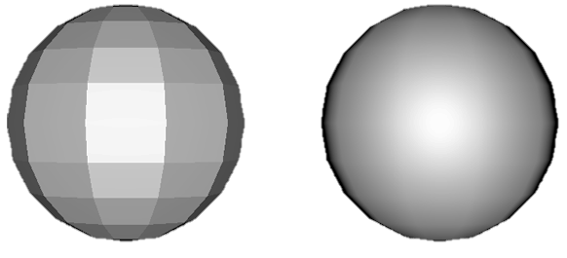
Smooth Shading
Interpolate vertex normals to smooth out edges
without smooth shading
with smooth shading
source: https://www.scratchapixel.com/lessons/3d-basic-rendering/introduction-to-shading/shading-normals

Slide 12
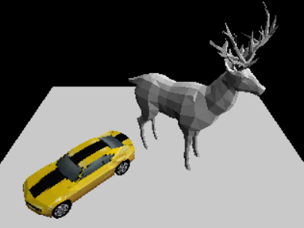
Software Implementation (1/3)
We implemented the rasterization-based rendering in Python before implementing hardware kernel with C++/HLS
Performance
640x480, ~0.2fps on Intel Core i7 @3GHz

Slide 13
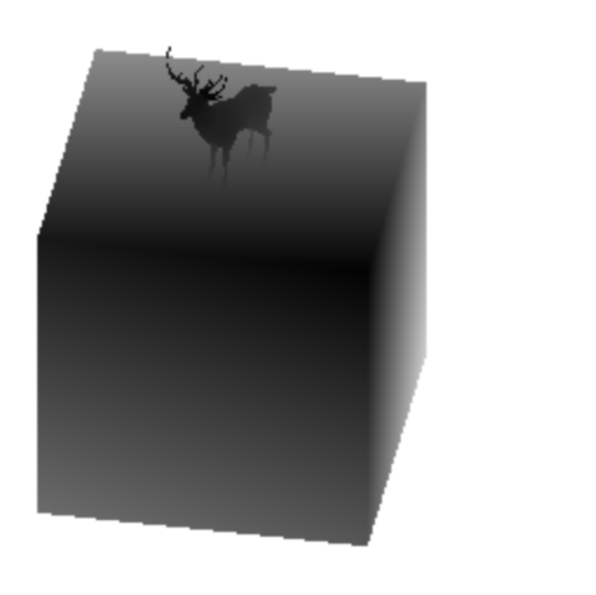
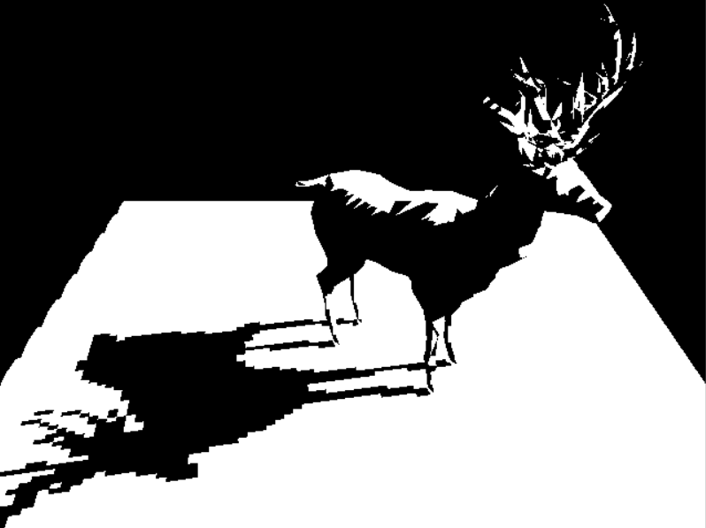
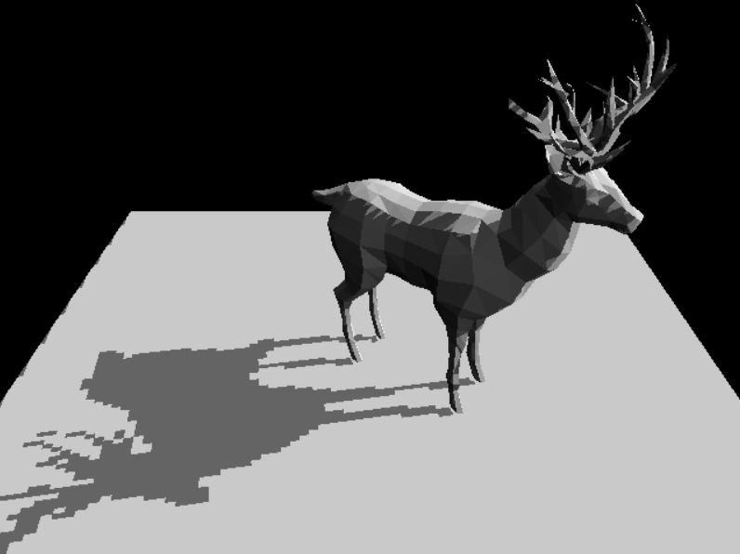
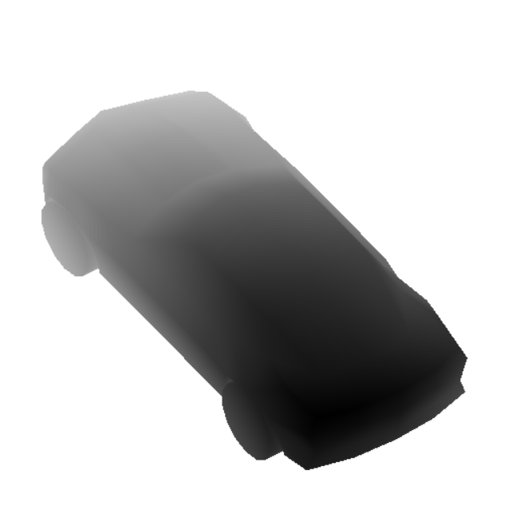

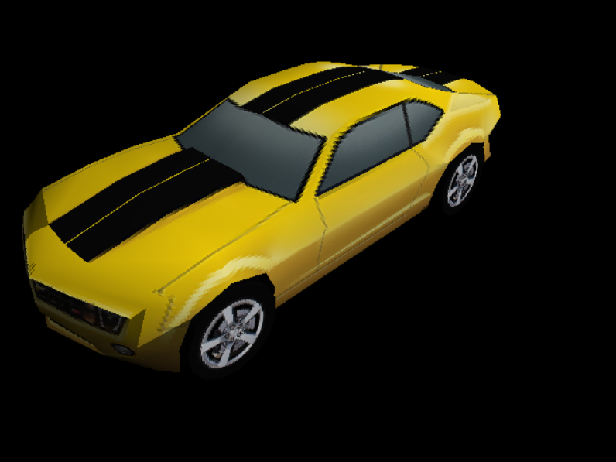
Software Implementation (2/3)
Example scene 1: cast shadow, no texture, no smooth shading
Example Scene 2: texture mapping, smooth shading
shadow map
shadow
render result

Slide 14
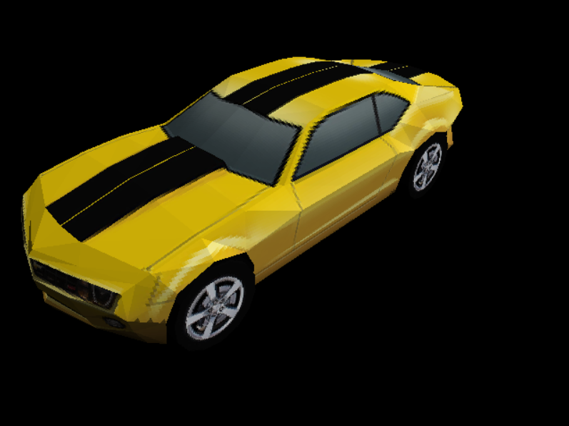
Software Implementation (3/3)
Comparison: smooth shading
with smooth shading
without smooth shading

Slide 15
Outline
Introduction
Algorithm Overview
Kernel Implementation
Design Optimization
System Integration
References

Slide 16
Kernel Interface Design (1/2)
64-bit AXI4-Stream for data input and output
2 floats per cycle
Each face is represented by 24 floats
3 vertices per face
3 coordinates (x, y, z)
3 normal vector (nx, ny, nz)
2 texture coordinates (tx, ty)
12 cycles per face

Slide 17
Kernel Interface Design (2/2)
Register map
Offset | Name | Description
0x00 | ap_control | Kernel start/done/idle/ready signals
0x10 | mode | Operating mode (0: reset, 1: texture, 2: mesh in, 3: frame out, 4: transform)
0x18 | num_faces | Number of faces
0x80 | obj_scale | Geometric transform object scale
0x88 | texture_id | Texture ID
0x40~0x7f | transform | Geometric transform matrix (3x4)
0x90~0x9f | lnorm | Light direction vector
0xa0~0xaf | cam_scale | Camera projection scale
0xb0~0xbf | cam_offset | Camera projection offset
0xc0~0xc7 | frameh | Frame height range

Slide 18
Kernel Operating Modes
Mode 0: reset
Reset frame buffer, depth buffer, and texture buffer
Mode 1: load texture
Load texture data (up to four textures)
Input: 2 RGBX pixels per cycle, total 64x64 pixels
Mode 2: mesh stream in and rasterize
Load face data and render a tile of frame
2 floats per cycle, total 24 floats per face
Input: (tx₀, ty₀), (nx₀, ny₀), (nz₀, vx₀), (vy₀, vz₀), (tx₀, ty₁), …

Slide 19
Kernel Operating Modes (2/2)
Mode 3: frame out
Store frame buffer to DRAM
Output: 2 RGBX pixels per cycle
Mode 4: geometric transform
Transform mesh data using a transform matrix
Input: 24-float face data (t, n, v)
Output: transformed 24-float face data (ct, cn, cv)

Slide 20
Implementing Geometric Transform
for (int i = 0; i < num_faces; i++) {
#pragma HLS pipeline II=12
apuint64_1_to_half_2(stream_input->read().data, t0[0], t0[1]);
// ... stream in 24 floats for each face
apuint64_1_to_half_2(stream_input->read().data, v2[1], v2[2]);
matrix_mul_vector(0, transform_h, obj_scale, v0, cv0);
matrix_mul_vector(0, transform_h, obj_scale, v1, cv1);
matrix_mul_vector(0, transform_h, obj_scale, v2, cv2); matrix_mul_vector(1, transform_h, 1.0, n0, cn0);
matrix_mul_vector(1, transform_h, 1.0, n1, cn1);
matrix_mul_vector(1, transform_h, 1.0, n2, cn2);
ct0[0] = t0[0]; ct0[1] = t0[1];
ct1[0] = t1[0]; ct1[1] = t1[1];
ct2[0] = t2[0]; ct2[1] = t2[1];
float_2_to_apuint64_1(ct0[0], ct0[1], stream_data.data);
stream_output->write(stream_data);
// ... stream out 24 floats for each face
float_2_to_apuint64_1(cv2[1], cv2[2], stream_data.data);
stream_output->write(stream_data);
}
Geometric transform is performed once per frame

Slide 21
Implementing Rasterization (1/2)
for (int i = 0; i < num_faces; i++) {
#pragma HLS pipeline II=12
apuint64_1_to_half_2(stream_input->read().data, ct0[0], ct0[1]);
// ... stream in 24 floats for each face
apuint64_1_to_half_2(stream_input->read().data, cv2[1], cv2[2]);
l0 = lambt+vector_dot_vector(cn0, lnormh)*(1.0-lambt);
l1 = lambt+vector_dot_vector(cn1, lnormh)*(1.0-lambt);
l2 = lambt+vector_dot_vector(cn2, lnormh)*(1.0-lambt);
cam_project(cv0, cam_scale, cam_offset, fv0, fv0i);
cam_project(cv1, cam_scale, cam_offset, fv1, fv1i);
cam_project(cv2, cam_scale, cam_offset, fv2, fv2i);
if ((fv0[2]<clip) && (fv1[2]<clip) && (fv2[2]<clip)) continue;
area = triangle_area(fv2, fv1, fv0);
if (area<=0) continue;
fz0_1 = 1/fv0[2];
fz1_1 = 1/fv1[2];
fz2_1 = 1/fv2[2];
fymax = imin(fh[1]-1, imax(fv0i[1], imax(fv1i[1], fv2i[1])));
fymin = imax( fh[0], imin(fv0i[1], imin(fv1i[1], fv2i[1])));
fxmax = imin( 640-1, imax(fv0i[0], imax(fv1i[0], fv2i[0])));
fxmin = imax( 0, imin(fv0i[0], imin(fv1i[0], fv2i[0])));
calculate vertex luminance
project point to frame
(fxmin, fymin)
calculate triangle bounding box
(fxmax, fymax)

Slide 22
Implementing Rasterization (2/2)
iterate through pixels in the bounding box
for (int fy = fymin; fy <= fymax; fy++) {
#pragma HLS pipeline
for (int fx = fxmin; fx <= fxmax; fx++) {
#pragma HLS pipeline
#pragma HLS dependence variable=depth_buffer inter false w0 = triangle_area(fx, fv2, fv1)/area;
w1 = triangle_area(fy, fv0, fv2)/area;
w2 = triangle_area( 1, fv1, fv0)/area;
if ((w0>=0) && (w1>=0) && (w2>=0)) {
fz_1 = w0*fz0_1+w1*fz1_1+w2*fz2_1;
fz = 1/fz_1;
if ((fz>=clip) && (fz<depth_buffer[fy-fh[0]][fx])) {
depth_buffer[fy-fh[0]][fx] = fz;
ct[0] = round(64*(w0*ct0[0]*fz0_1+w1*ct1[0]*fz1_1+w2*ct2[0]*fz2_1)*fz);
ct[1] = round(64*(w0*ct0[1]*fz0_1+w1*ct1[1]*fz1_1+w2*ct2[1]*fz2_1)*fz); lum = (w0*l0*fz0_1+w1*l1*fz1_1+w2*l2*fz2_1)*fz; frame_buffer[fy-fh[0]][fx][0] = (texture[texture_id][ct[0]][ct[1]][0])*lum;
frame_buffer[fy-fh[0]][fx][1] = (texture[texture_id][ct[0]][ct[1]][1])*lum;
frame_buffer[fy-fh[0]][fx][2] = (texture[texture_id][ct[0]][ct[1]][2])*lum;
}
}
}
}
check if pixel is inside the triangle
visibility checking
perspective-corrected interpolation
frame buffer update

Slide 23
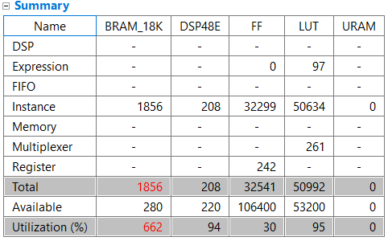
HLS Synthesis Result
Using too much BRAM resource
Cannot be deployed to ZedBoard
High LUT usage, need to reserve some LUTs for integration

Slide 24
Outline
Introduction
Algorithm Overview
Kernel Implementation
Design Optimization
System Integration
References

Slide 25
Using Half-precision Floating-points (1/2)
The resource usage is too high for a 32-bit float design
We can trade off precision for lower resource usage
Example:
A half multiplier (dspnone): 159LUTs, 204FFs
A float multiplier (dspnone): 567LUTs, 692FFs
Overall 2~3x less resource
https://www.xilinx.com/support/documentation/ip_documentation/ru/floating-point.html

Slide 26
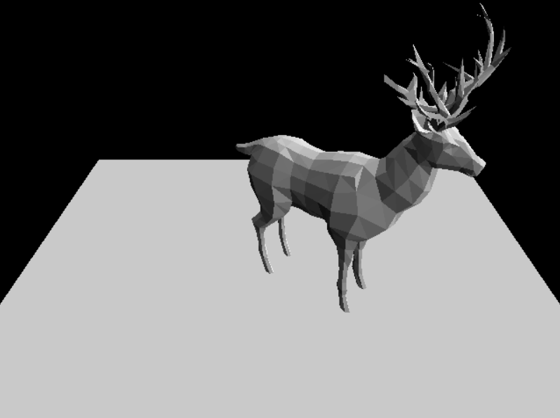
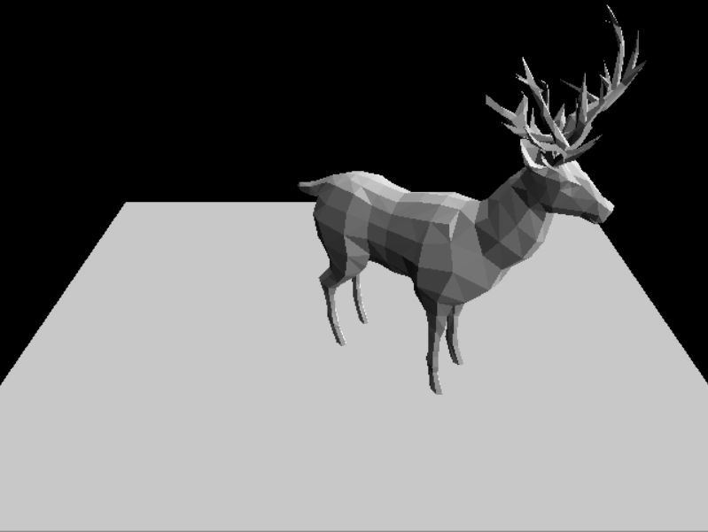
Using Half-precision Floating-points (2/2)
Render results comparison: float vs. half
No significant difference under 640x480 resolution
float (32-bit)
half (16-bit)

Slide 27
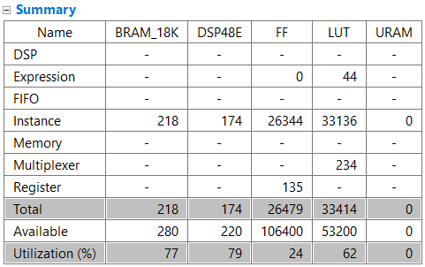
Tiled Frame Rendering
A 640x480 RGB frame is too large for ZedBoard BRAM
Reduce buffer to 640x60, render a frame in 8 iterations
Face data is streamed in each iteration
Frame buffer is streamed out after rasterizing all objects
Results:
-88%
-16%
-20%
-35%

Slide 28
Outline
Introduction
Algorithm Overview
Kernel Implementation
Design Optimization
System Integration
References

Slide 29
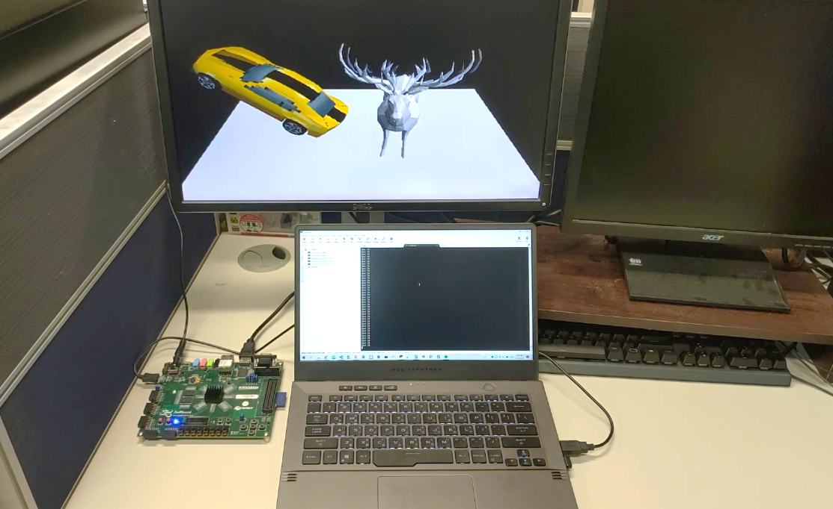
System Specifications
Platform: ZedBoard
Frequency: 250 MHz (synthesized under 100 MHz)
Video format: 640x480 (HDMI)
Frame rate: 20fps (depending on number of faces) 1200x speed up compare to Core i7, frequency normalized

Slide 30
HDMI Output Integration (1/2)
ZedBoard uses ADV7511 as an HDMI transmitter
To integrate ADV7511 in the system:
Use ADX_HDMI_TX IP provided by Analog Devices
Use Xilinx AXI IIC IP to configure ADV7511
Initialize ADX_HDMI_TX registers using PYNQ
Initialize ADV7511 registers using PYNQ
Use Xilinx Video Test Pattern Generator to test HDMI
Integrate Xilinx Video Frame Buffer Read for frame reading

Slide 31
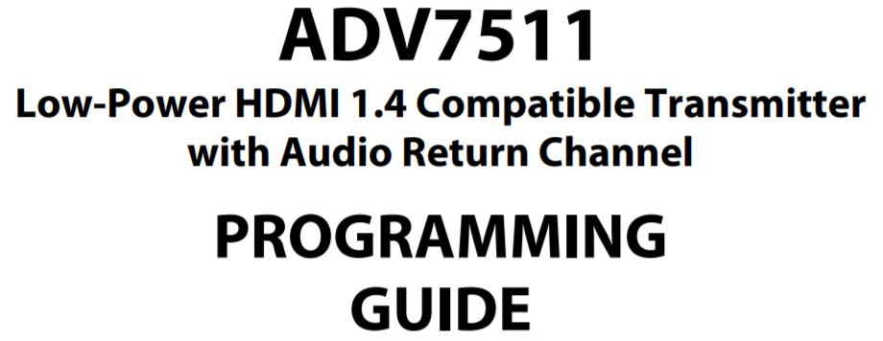
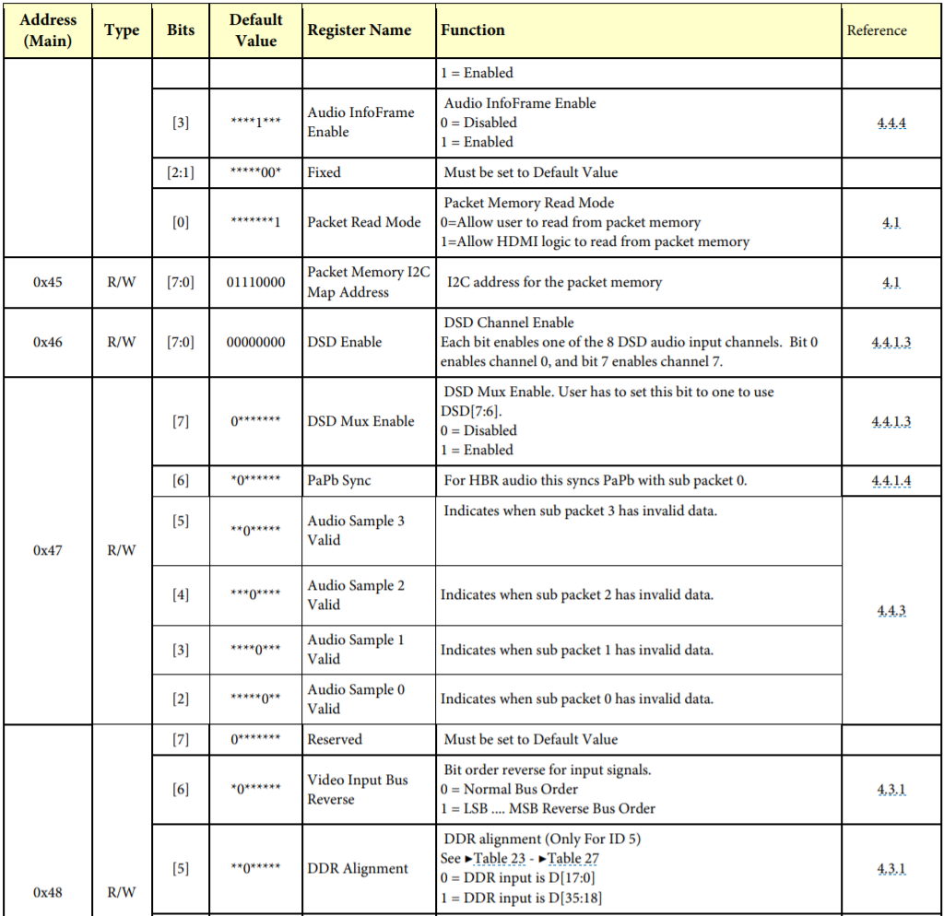
HDMI Output Integration (2/2)
ADV7511 Programming (I²C)
ipIIC.send(0x39, bytes([0x41, 0x50]), 2) # power down
ipIIC.send(0x39, bytes([0x15, 0x01]), 2) # 16,20,24b YCbCr422
ipIIC.send(0x39, bytes([0x16, 0x35]), 2) # 4:4:4, 8b, style2,
ipIIC.send(0x39, bytes([0x17, 0x00]), 2) # 4:3
ipIIC.send(0x39, bytes([0x40, 0x80]), 2) # GC packet enable
ipIIC.send(0x39, bytes([0x48, 0x08]), 2) # bit right justified
ipIIC.send(0x39, bytes([0x49, 0xa8]), 2) # bit trim: truncate
ipIIC.send(0x39, bytes([0x98, 0x03]), 2) # fixed
ipIIC.send(0x39, bytes([0x9a, 0xe0]), 2) # fixed
ipIIC.send(0x39, bytes([0x9c, 0x30]), 2) # fixed
ipIIC.send(0x39, bytes([0x9d, 0x61]), 2) # fixed
ipIIC.send(0x39, bytes([0xa2, 0xa4]), 2) # fixed
ipIIC.send(0x39, bytes([0xa3, 0xa4]), 2) # fixed
ipIIC.send(0x39, bytes([0xaf, 0x06]), 2) # HDMI mode
ipIIC.send(0x39, bytes([0xe0, 0xd0]), 2) # fixed
ipIIC.send(0x39, bytes([0xf9, 0x00]), 2) # fixed
ipIIC.send(0x39, bytes([0xd6, 0xc0]), 2)
ipIIC.send(0x39, bytes([0x41, 0x10]), 2) # power up
ADV7511 register specs
our programming sequence in PYNQ

Slide 32
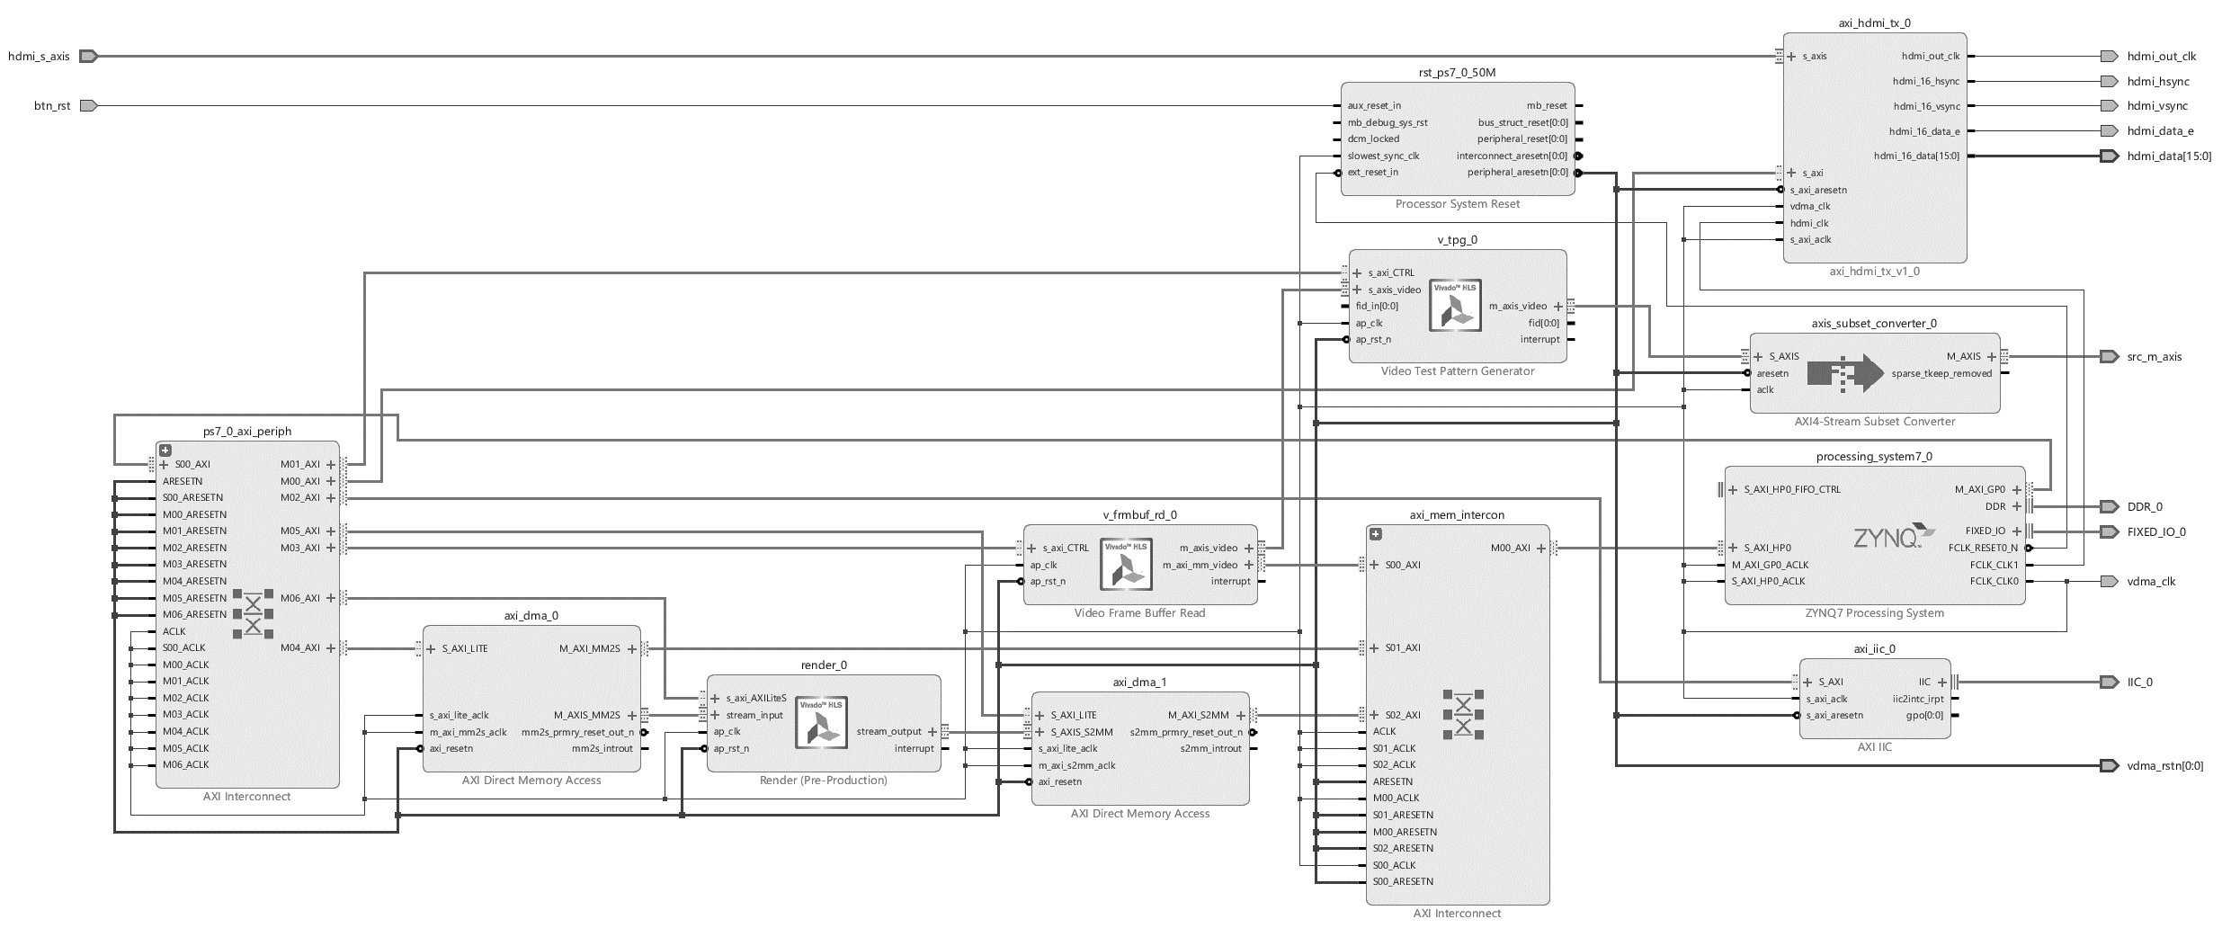
System Block Diagram
HDMI Controller
Video Test Pattern
Generator
Frame Buffer Reader
ZYNQ
Render kernel
I²C for ADV7511
Control Interconnect
Input DMA
OutputDMA
Data Interconnect

Slide 33
Hardware-Software Scheduling (1/4)
Use separate render kernel thread (runs on kernel) and scene control thread (runs on host CPU)
Rasterization is a pixel-wise operation
Require hardware kernel to accelerate
Scene logic and transform matrices are object-wise operations
Can be done by CPU in real-time
foreach frame:
render_thread.start()
// scene logic
// calculate object transform matrix
// calculate light transform matrix
// calculate camera matrix
render_thread.join()

Slide 34
Hardware-Software Scheduling (2/4)
Use separate render kernel thread (runs on kernel) and scene control thread (runs on host CPU)
function render_thread():
for obj in objects:
kernel.transform(obj, obj.transform)
for iteration in [0,8):
kernel.set_frame_tile_range(60*(i+0),
60*(i+1))
for obj in objects:
kernel.set_num_faces(obj)
kernel.set_texture_id(obj)
kernel.rasterize(obj)
kernel.store_frame_tile(frame_buffer)
return
foreach frame:
render_thread.start()
...
render_thread.join()

Slide 35
Hardware-Software Scheduling (3/4)
System scheduling
time
Scene
Thread
(software)
Video IPs init
Load model from SD card
Render kernel init
Scene logic (frame 1)
Scene logic (frame 2)
Scene logic (frame 3)
fork
join
fork
join
fork
Model data (DRAM)
Render
Thread
(hardware)
Render routine (frame 1)
Render routine (frame 2)
Render (frame 3)
Frame buffer (DRAM)
Frame
Buffer
(hardware)
Frame Buffer Read
Frame Buffer Read
Frame Buffer Read
Frame Buffer Read
Frame Buffer Read
Frame Buffer Read
Frame Buffer Read
HDMI
HDMI
HDMI
HDMI
HDMI
HDMI
HDMI

Slide 36
Hardware-Software Scheduling (4/4)
Render routine (hardware)
time
Render frame1
Render frame 2
Render frame 3
Render frame 4
Render
routine
Geometric transform
Rasterize
Frame Tile 1
Rasterize
Frame Tile 2
…
Rasterize
Frame Tile 8
Geo. trans
routine
Set obj1 trans
Run trans
kernel
…
Set objN trans
Run trans
kernel
Rasterize
routine
Frame Tile
range setup
Reset
buffers
Rasterize
obj1
…
Rasterize
objN
Store
frame buffer
time

Slide 37
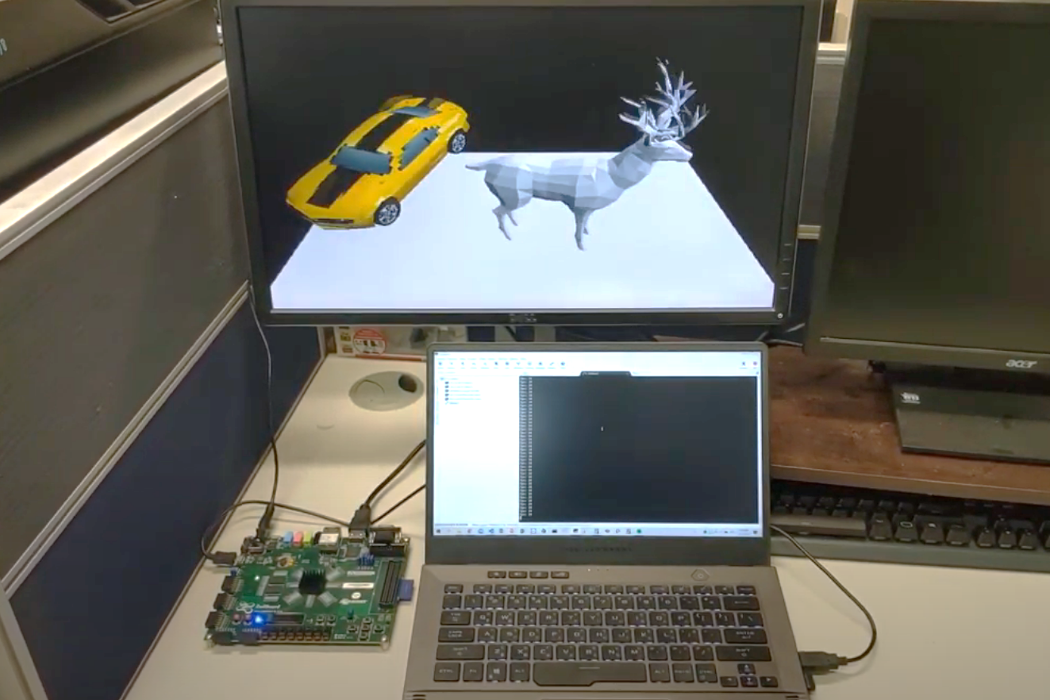
Demo
Demo setup: https://youtu.be/3ftIn4NvHJQ
Close-up: https://youtu.be/YF6Qrvv0G5I
640x480
resolution
UART terminal
HDMI
output
ZedBoard

Slide 38
References
[1] https://www.scratchapixel.com/lessons/3d-basic-rendering/rasterization-practical-implementation
[2] https://learnopengl.com/Advanced-Lighting/Shadows/Shadow-Mapping
[3] https://www.xilinx.com/support/documentation/sw_manuals/xilinx2018_3/ug902-vivado-high-level-synthesis.pdf

